Slide 1
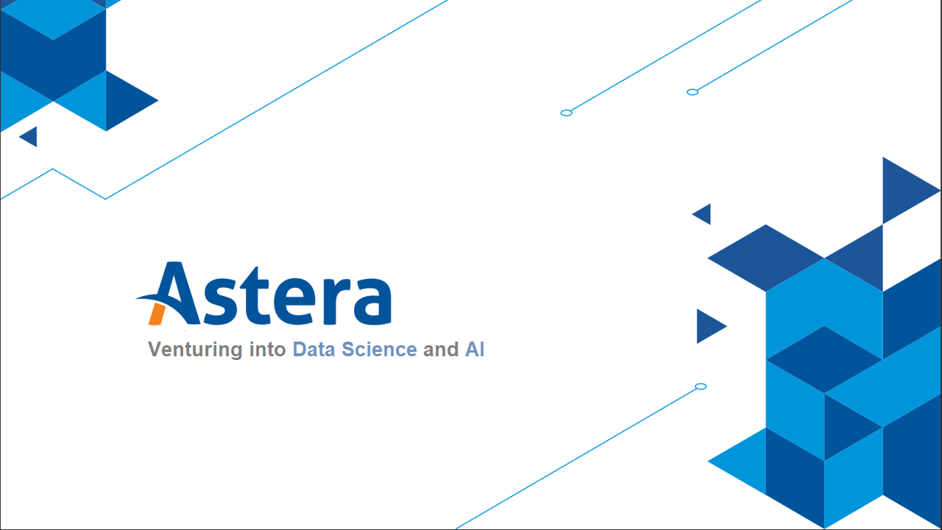
Notes:
In 2018, in China, there were two rounds of competition held of a team of elite neuro surgeons against a neuroimaging AI system called BioMind. This AI system beat human doctors in neuroimaging recognition contest with a 2:0 score.
Walmart, the world’s largest retailer, supposedly found out that there are certain times at which beer and diapers sell particularly well together – when on Friday evenings young men make a last dash to the supermarket to get beer and their wives call after them, “Pick up some diapers, too, honey!”
“Some of the ways Wal-Mart managers found to exploit their findings are legendary. One such legend is the story, “diapers and beer”. Wal-Mart discovered through data mining that the sales of diapers and beer were correlated on Friday nights. It determined that the correlation was based on working men who had been asked to pick up diapers on their way home from work. On Fridays the men figured they deserved a six-pack of beer for their trouble; hence the connection between beer and diapers. By moving these two items closer together, Wal-Mart reportedly saw the sales of both items increase geometrically.”

Slide 2

Topics
Dealing with Missing Value
Dealing with Outliers
Dealing with non-constant variance
Dealing with multicollinearity
Test/Train splits

Slide 3
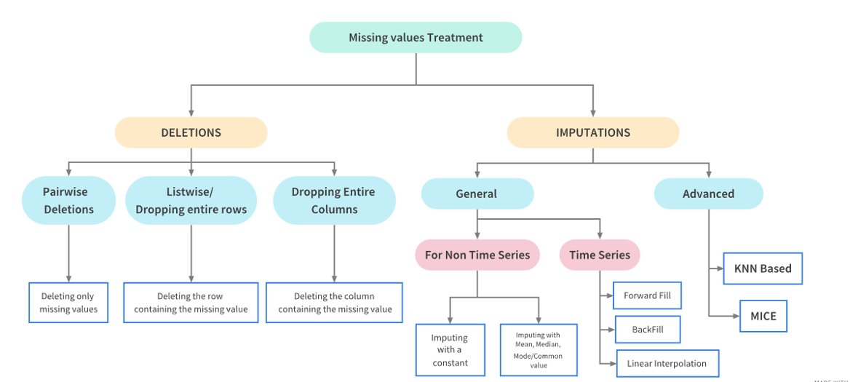
Dealing with Missing Values

Slide 4
Dealing with Outliers

Slide 5

What is an Outlier?
An outlier is a data point that differs significantly from other observations
Notes:
Must watch before moving forward
https://www.youtube.com/watch?v=Txlm4ORI4Gs

Slide 6
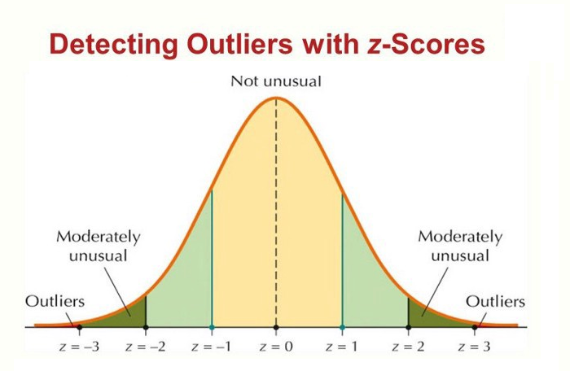
Outlier Detection: Z-Scores

Slide 7
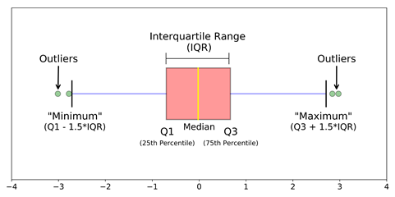
Outlier Detection: IQR (Inter-Quartile Range)

Slide 8
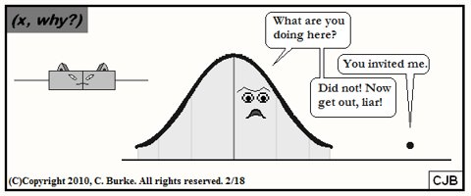
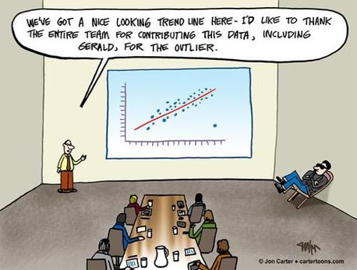
Outliers Matters A Lot!

Slide 9
Treating an Outlier
Trimming/removing the outlier
Quantile based flooring and capping
Mean/Median imputation

Slide 10
Dealing with Multicollinearity

Slide 11
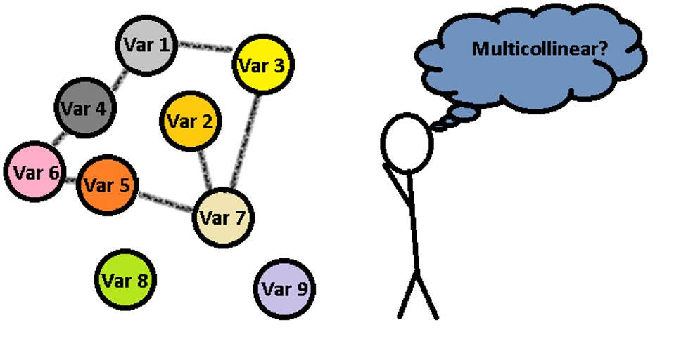
What is Multicollinearity?
Occurrence of high intercorrelations among two or more independent variables in a multiple regression model
Notes:
Multicollinearity is the occurrence of high intercorrelations among two or more independent variables in a multiple regression model

Slide 12









Slide 13
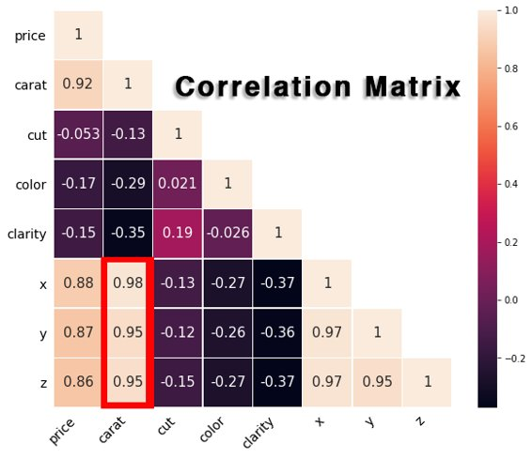
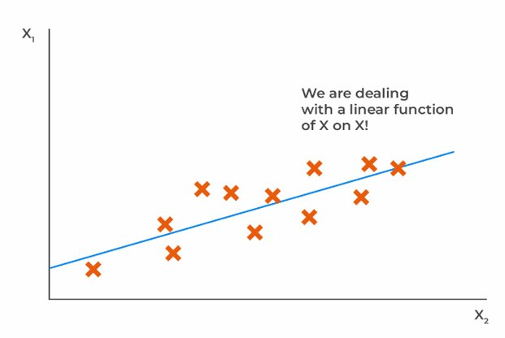
Detecting Multicollinearity
Notes:
Too many cooks spoil the broth
Adding more variables isn’t smart
Why is this a problem?
Unreliable coefficient estimates because the effect of one independent variable might be induced twice in the equation
Leads to overfitting
One detection is that while the p-value of each independent variable is insignificant, there model turns out to be overall significant. (quite absurd!)
VIF: Variance inflation factor measures how much the behavior (variance) of an independent variable is influenced, or inflated, by its interaction/correlation with the other independent variables

Slide 14


Slide 15
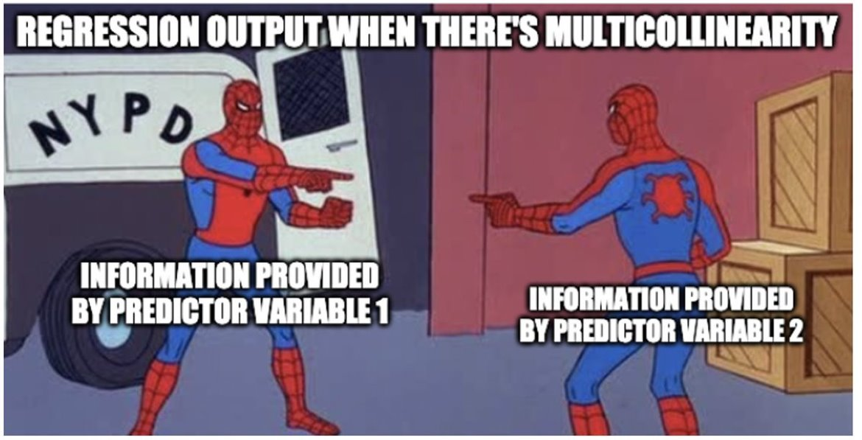
Notes:
Implications of multicollinearity
Will discuss in week 4

Slide 16
Redeeming Multicollinearity
Live with it!
Remove statistically redundant variables
Instrumental variable
Dimension Reduction Methods
Regularized Regression

Slide 17
Dealing with Non-Constant Variance

Slide 18
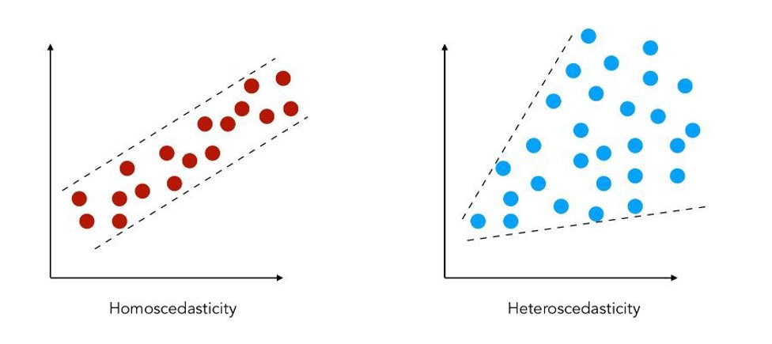


Heteroskedasticity: (Non-Constant Variance)
Heteroskedasticity generally refers to an unequal scattering of data points.
Notes:
This is a term derived from Greek language, meaning cone-shaped and if you plot the graph, you see the spread of data points is cone-shaped, though now that is not the only indicator. For example, if you plot income against saving plot, you are bound to find this pattern. Can also arise due to presence of outliers or incorrect variable transformation.
Commonly found in cross-sectional data than time series. Heteroskedasticity refers to situations where the variance of the residuals is unequal over a range of measured values.
Why is this a problem?
Mostly do not affect coefficient estimation but can lead to overestimation/underestimation of prediction
Might be a fine diagnostic model but bad predictive model

Slide 19
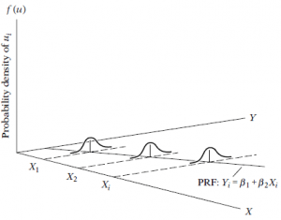
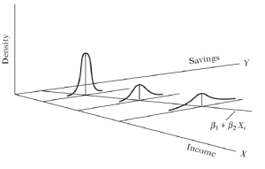
Heteroskedasticity: (Non-Constant Variance)
Homoscedastic
Heteroscedastic

Slide 20
Redeeming Heteroskedasticity
Transform Y
Weighted Least Square
Redeem Omitted Variable Bias
Notes:
Discuss Direct and indirect heteroskedasticity.

Slide 21
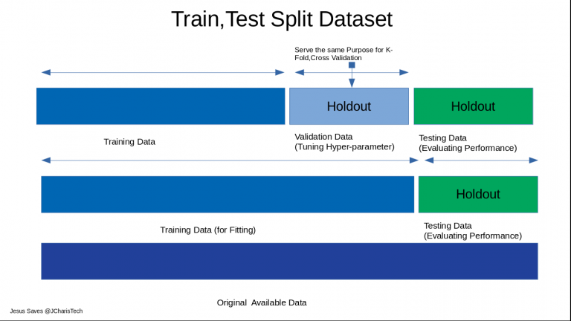
Test/Train Split

Slide 22

THANK YOU
Training and Certification

